Slide 1

CONSERVATION BIOLOGY
By Bradley J. Cardinale and James D. Murdoch

Slide 2
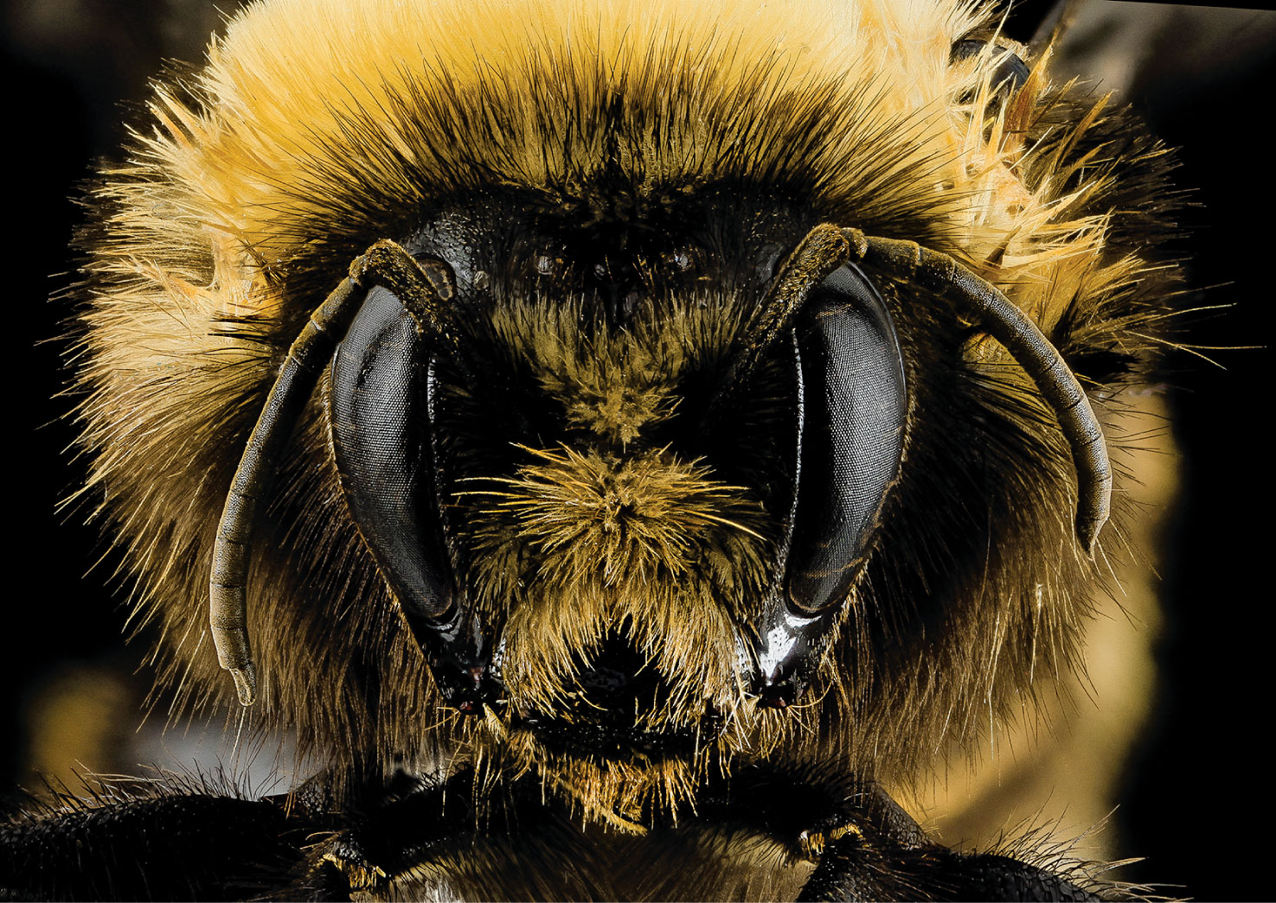
2
Notes:
The genus Bombus, commonly known as bumblebees, includes 260 species worldwide that provide important ecosystem services like pollination of crops and wildflowers. Unfortunately, the International Union for Conservation of Nature’s Red List shows 22 of these species as threatened with extinction.

Slide 3
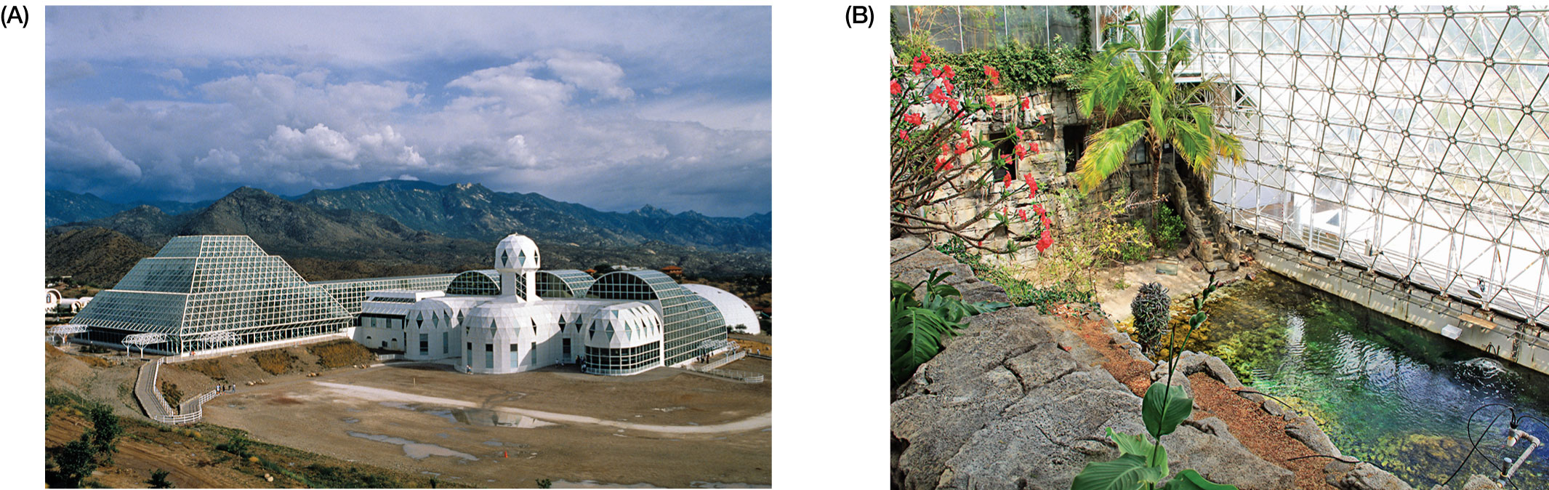
Figure 6.1 (A) Biosphere 2, located near Tucson, Arizona, was constructed to be the largest materially enclosed ecosystem on Earth.
Notes:
Figure 6.1 (A) Biosphere 2, located near Tucson, Arizona, was constructed to be the largest materially enclosed ecosystem on Earth. It was originally intended to demonstrate the potential of using closed systems to sustain human life on another planet. (B) Biologists and engineers spent four years designing and landscaping Biosphere 2 to have all the ecosystems needed to sustain life, including this mini-ocean to help control the climate. But after eight researchers were locked inside the airtight environment on September 26, 1991, levels of CO₂ increased, O₂ declined, and most vertebrate species and pollinating insects began to die. As researchers began to experience significant weight loss, headaches, and exhaustion, it became clear that human health and welfare could no longer be maintained inside the biosphere, and the experiment was terminated. Biosphere 2 was a sobering reminder that we don’t yet have the basic understanding needed to design ecological systems that can maintain human life.

Slide 4
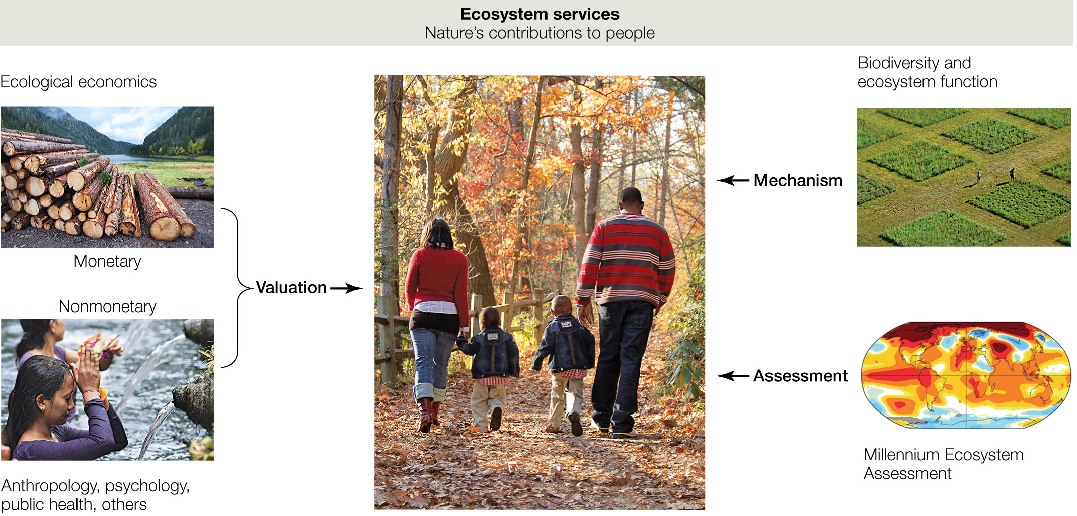
Figure 6.2 While the concept of nature’s services is old, the term ecosystem services was popularized in the 1990s by the convergence of three areas of study:
Notes:
Figure 6.2 While the concept of nature’s services is old, the term ecosystem services was popularized in the 1990s by the convergence of three areas of study: (1) multiple disciplines began to estimate the monetary and nonmonetary values of ecosystems and their biodiversity, (2) the field of biodiversity and ecosystem functioning began to identify the mechanistic evidence linking biodiversity to ecosystem processes and services, and (3) the Millennium Ecosystem Assessment critiqued the state of Earth’s ecosystems and showed that the services they provide are rapidly deteriorating in the modern era.

Slide 5
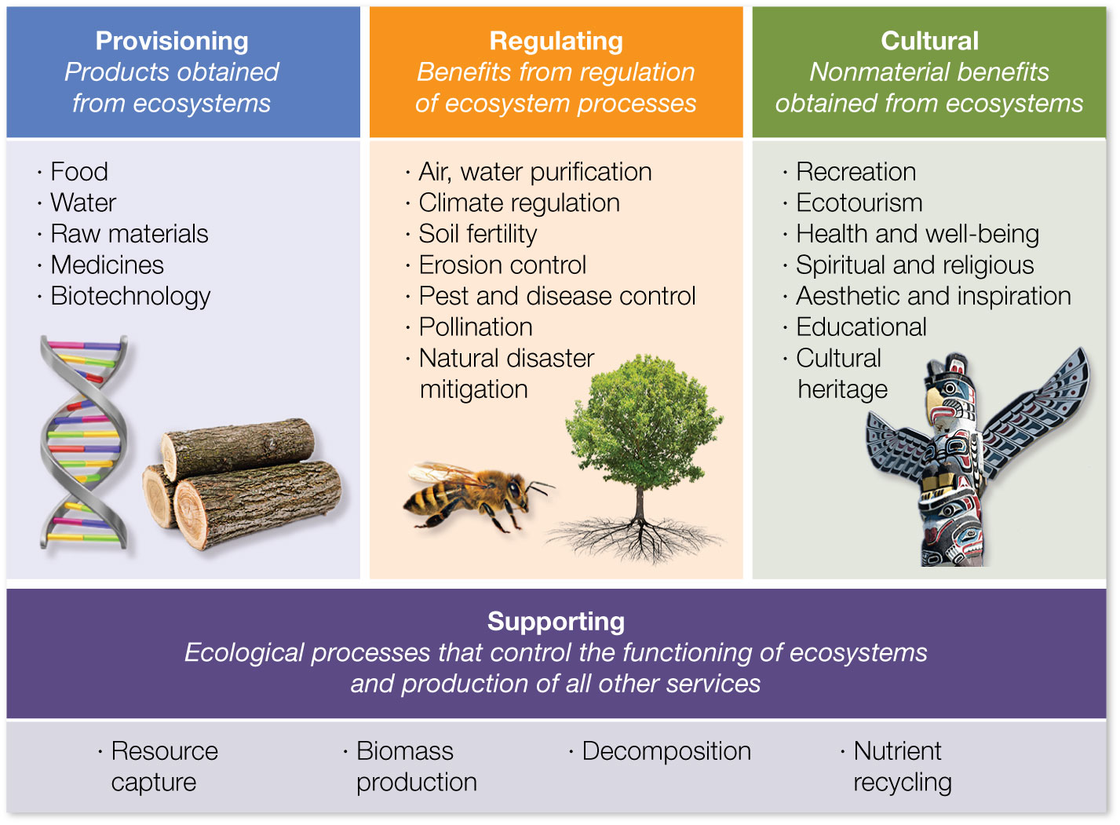
Figure 6.3 The Millennium Ecosystem Assessment’s framework organizes ecosystem services into four categories: supporting, provisioning, regulating, and cultural.
Notes:
Figure 6.3 The Millennium Ecosystem Assessment’s framework organizes ecosystem services into four categories: supporting, provisioning, regulating, and cultural.

Slide 6
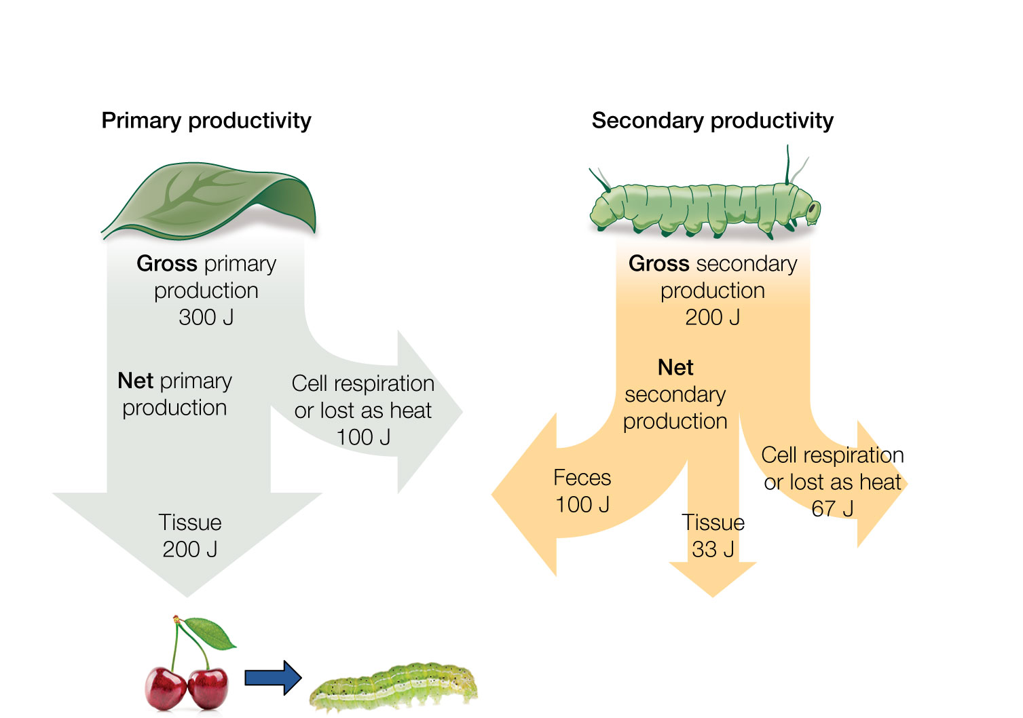
Figure 6.4 Fluxes of energy that control rates of primary and secondary production in autotrophs (e.g., plants and algae) and heterotrophs (e.g., bacteria, fungi, animals).
Notes:
Figure 6.4 Fluxes of energy that control rates of primary and secondary production in autotrophs (e.g., plants and algae) and heterotrophs (e.g., bacteria, fungi, animals). Biomass production is a supporting service that influences the production of nearly all other ecosystem services.

Slide 7
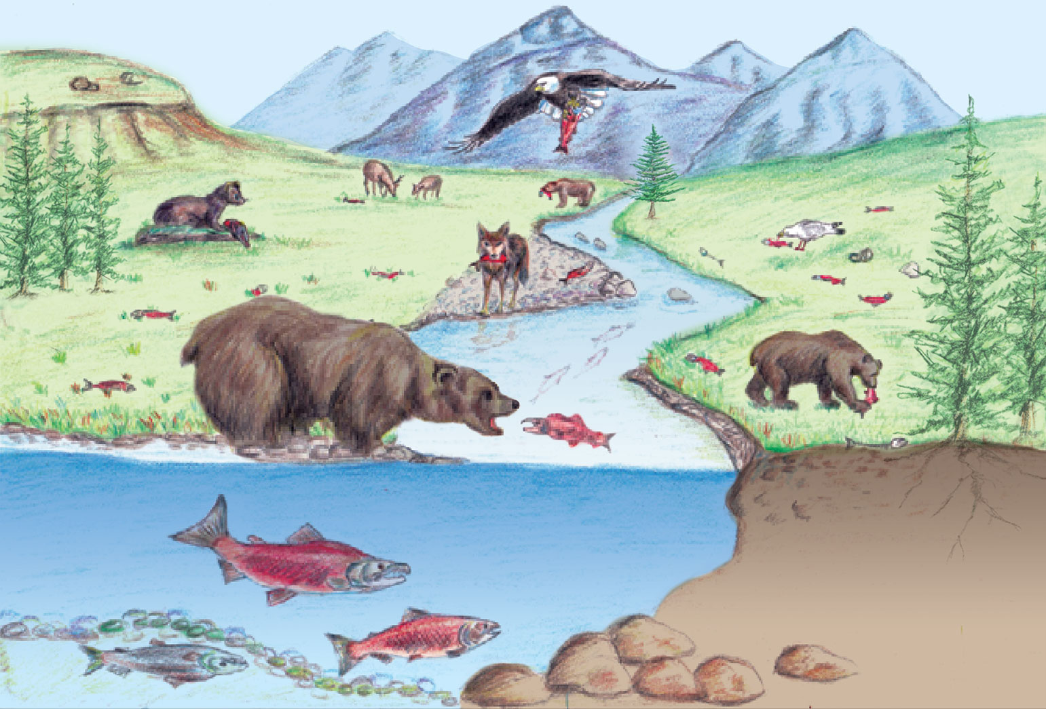
Figure 6.5 Supporting services like decomposition and nutrient recycling are crucial to the proper functioning of ecosystems, and they support entire food webs.
Notes:
Figure 6.5 Supporting services like decomposition and nutrient recycling are crucial to the proper functioning of ecosystems, and they support entire food webs. Here, Pacific salmon that are captured in a stream are transported into terrestrial habitats, where they are deposited by predators like birds or bears. As they decompose, their nutrient recycling fuels the growth of everything from spiders to lizards to mice to trees.

Slide 8
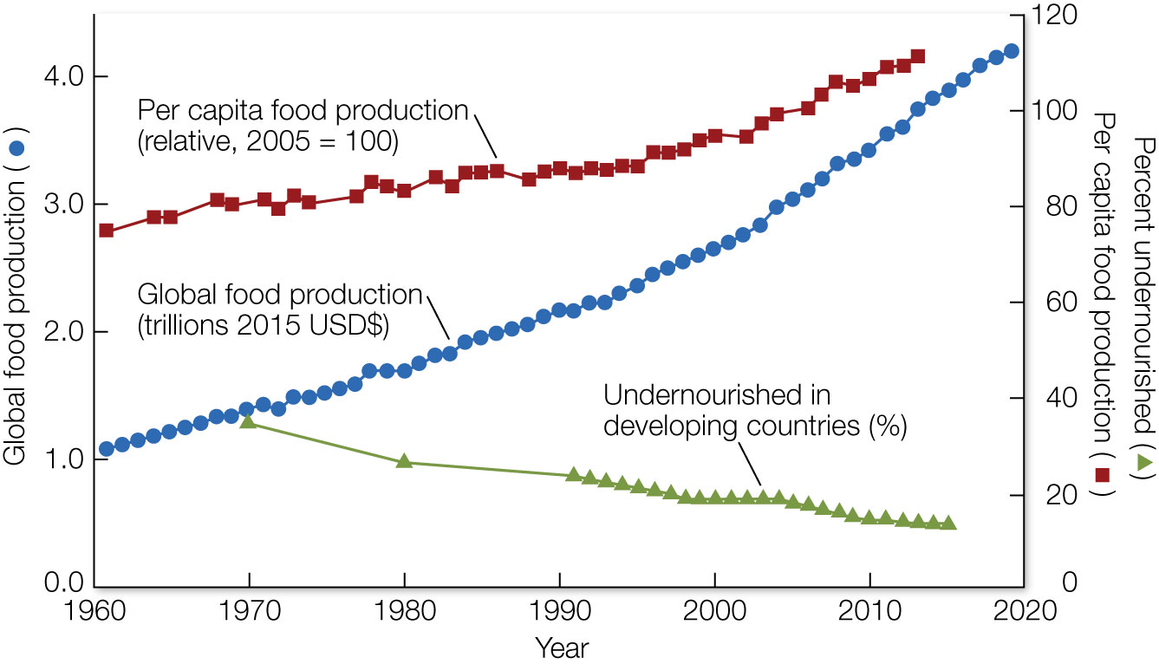
Figure 6.6 Food production is one of the few provisioning services of ecosystems that has shown a consistent upward trend.
Notes:
Figure 6.6 Food production is one of the few provisioning services of ecosystems that has shown a consistent upward trend. Global food production in agroecosystems, both the total (circles, blue line) and the per capita production (squares, red line), has consistently increased since the 1960s while food prices have remained relatively constant. The prevalence of undernourishment in developing countries (triangles, green line) has decreased, though 842 million people (1 in 8) remain undernourished.

Slide 9
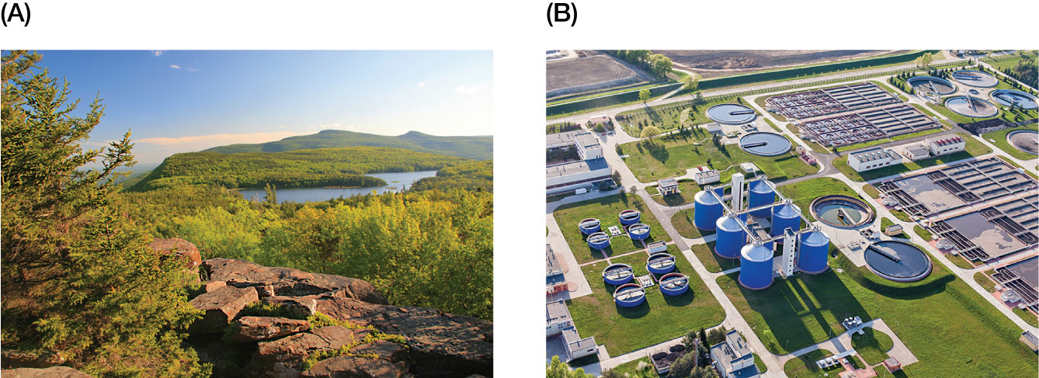
9
Notes:
To protect its drinking water, New York City decided it would be a smart and profitable investment to conserve the Catskill Mountains that purify water naturally (A), as opposed to building expensive water treatment facilities (B).

Slide 10
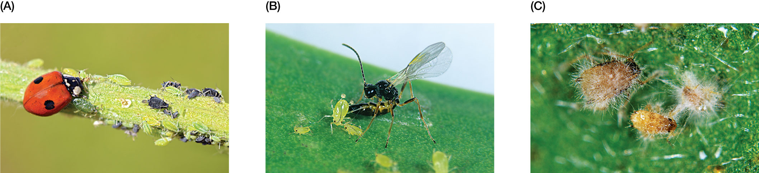
Figure 6.7 Biological control of insect pests by predators, parasitoids, and pathogens is an important regulating service of ecosystems worth billions of dollars in crop protection.
Notes:
Figure 6.7 Biological control of insect pests by predators, parasitoids, and pathogens is an important regulating service of ecosystems worth billions of dollars in crop protection. (A) A predacious lady beetle eats aphid herbivores on a crop. (B) A parasitoid wasp oviposits an egg into an aphid. The egg will hatch into a larva, which will develop inside the aphid and consume the aphid from the inside out. (C) A fungal pathogen kills aphids and absorbs their tissues for nutrition.

Slide 11
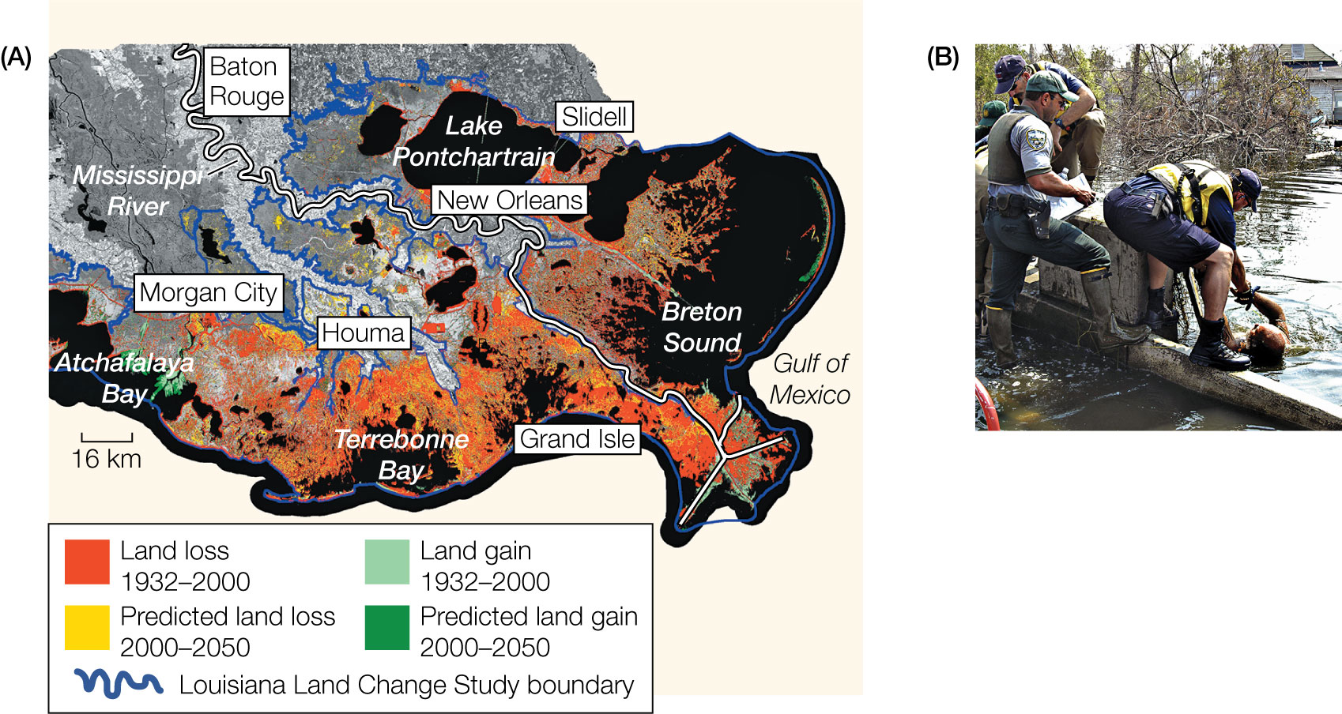
11
Notes:
(A) Loss of coastal wetlands from 1932 to 2000 (shown in red) was severe in the southern Louisiana area, leaving New Orleans with no natural infrastructure that could provide flood protection from hurricanes. (B) When Hurricane Katrina hit New Orleans in 2005, storm surge caused 53 breaches to floodprotection structures, submerging 80% of the city and causing 1,836 fatalities and $125 billion in damage.

Slide 12
TABLE 6.1 Select examples that illustrate the value of ecosystem services associated with outdoor recreational activities
Activity | Location | Year | Users | Annual valueª | Reference
Wildlife viewing | National Wildlife Refuge System, United States | 2011 | 46.5 million visitors | $2.6 billion | E. Carver and J. Caudill, U.S. Fish & Wildlife Service Report (2013)⁷⁵
Recreational hunting | Public land in Michigan, United States | 2002 | 7.7–12.1 million hunting trips | $109.6 million | S. Knoche and F. Lupi, J Wildl Manage (2012)⁷⁶
Recreational fishing | Moreton Bay Marine Park, Australia | 2008 | 337,000 fishing trips | $22.9 million | S. Pascoe et al., Tourism Manage (2014)⁷⁴
Bird-watching | Kuscenneti National Park, Turkey | 2001 | About 10,000 visitors who come to the wetlands to view migratory birds | $143 million | S. Gurluk and E. Rehber, J Environ Man (2008)⁷⁷
Boating | Lake Ontario & St. Lawrence River, United States and Canada | 2002 | 32,702 boat owners; 1.3 million recreation days | $123.3 million | N. A. Connelly et al., J Am Water Res Assoc (2007)⁷⁸
Mountain biking | Moab, Utah, United States | 1994 | 900 mountain bikers who used biking trails in Moab | $2.2 million | K. Chakraborty and J. E. Keith, J Environ Plan Man (2000)⁷⁹
ªAll values are in 2018 U.S. dollars.
Notes:
TABLE 6.1 Select examples that illustrate the value of ecosystem services associated with outdoor recreational activities

Slide 13
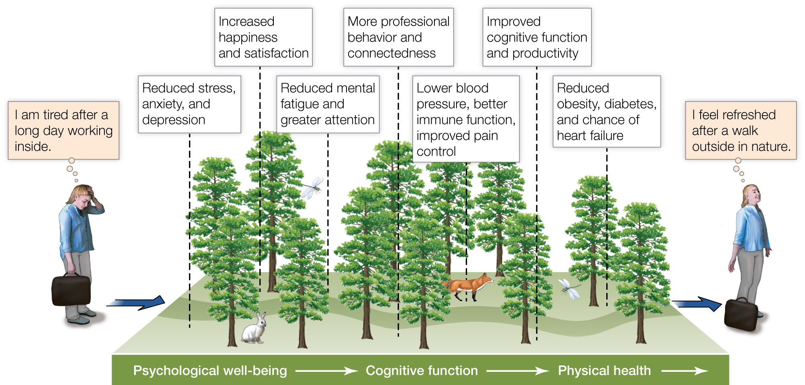
Figure 6.8 Two reviews (Frumkin et al., 2017; Keniger et al., 2013)84, 85 summarized literature linking outdoor activities and human health.
Notes:
Figure 6.8 Two reviews (Frumkin et al., 2017; Keniger et al., 2013)84, 85 summarized literature linking outdoor activities and human health. Both concluded there is strong evidence that spending time in nature improves psychological well-being, cognitive function, and physical health.

Slide 14
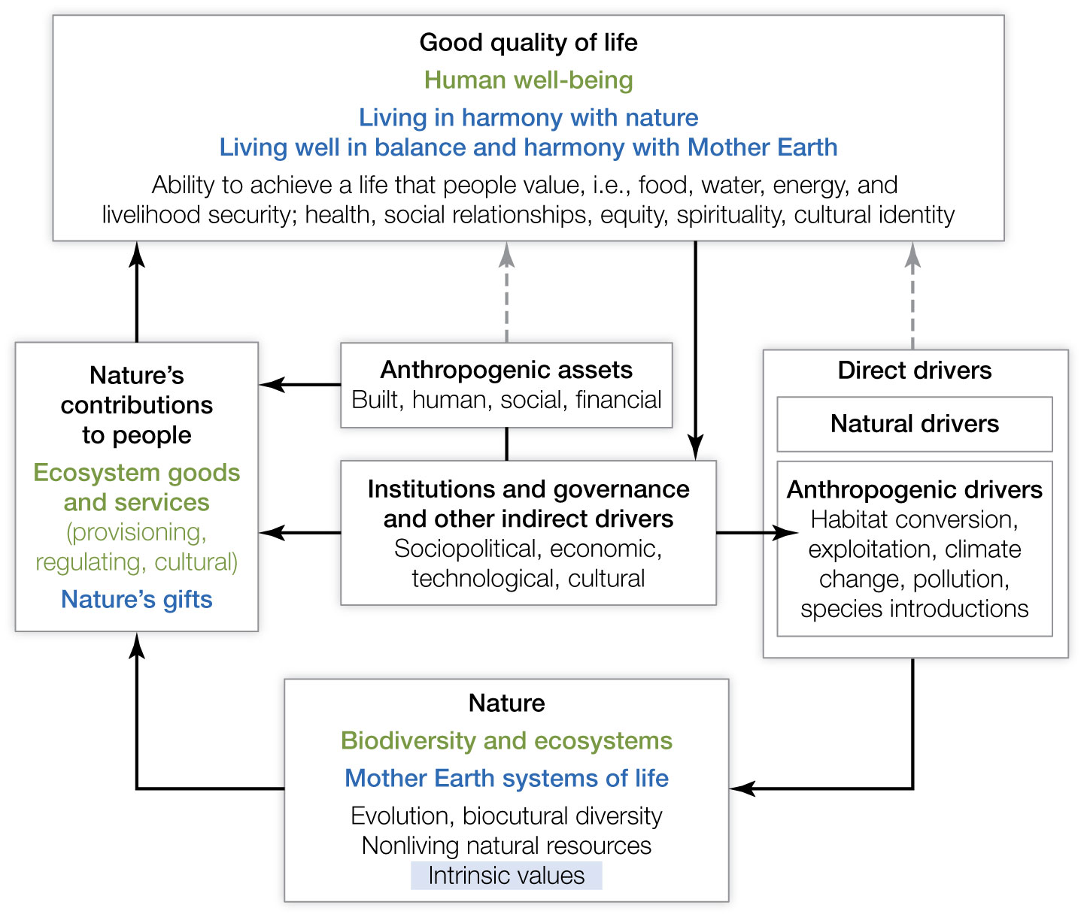
Figure 6.9 The conceptual framework adopted by the Intergovernmental Science–Policy Platform on Biodiversity and Ecosystem Services (IPBES).
Notes:
Figure 6.9 The conceptual framework adopted by the Intergovernmental Science–Policy Platform on Biodiversity and Ecosystem Services (IPBES). Boxes denote the elements of nature and society that are the main focus of IPBES, while arrows show how those elements influence each other. In each of the boxes, the headlines in black are categories that should be intelligible and relevant to all stakeholders. Concepts in green are specific to Western cultures, whereas concepts common in other knowledge systems (e.g., Eastern cultures, Indigenous peoples) are shown in blue.

Slide 15
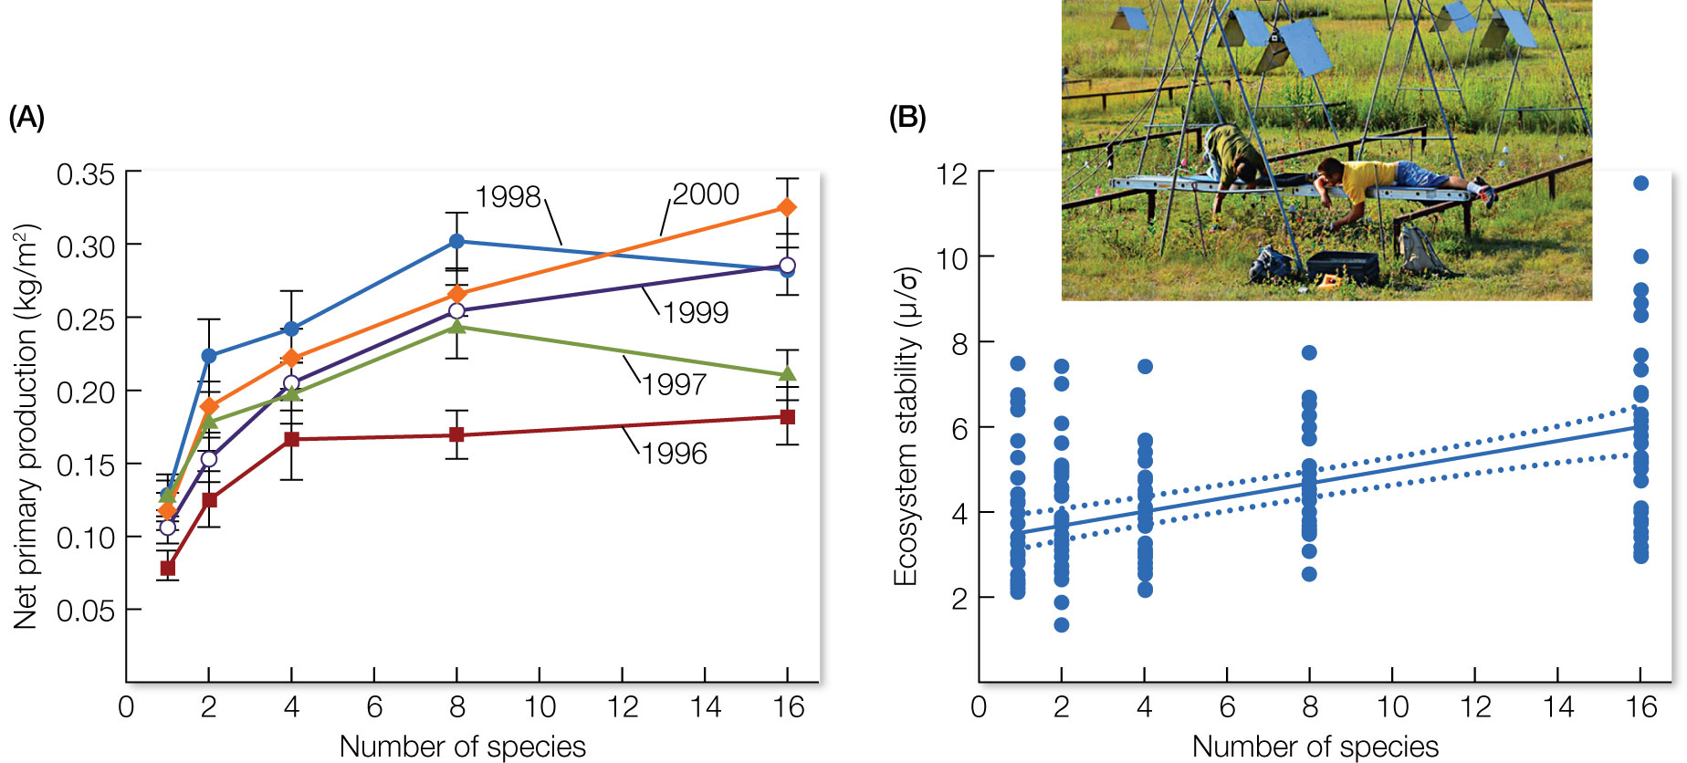
Figure 6.10 Seminal experiments showed that biodiversity regulates the supporting services of ecosystems.
Notes:
Figure 6.10 Seminal experiments showed that biodiversity regulates the supporting services of ecosystems. In one such experiment performed at the University of Minnesota’s Cedar Creek Ecosystem Science Reserve, scientists planted 168 plots, 81 m2 each, with 1 to 16 species of grassland plant (inset). They found that the net production of plant biomass increased with the number of species in a plot, with effects growing stronger over time (A). They also found that plant richness reduced annual variation in plant biomass for more than a decade, thus helping to make the ecosystem more stable (B).

Slide 16
TABLE 6.2 A summary of evidence linking biodiversity to the provisioning and regulating services of ecosystems
Category | Ecosystem service | Service-providing organism(s) | Diversity level | Study type | N | Relationship
PROVISIONING
Food | Crop yield | Plants | Genetic | Exp | 575 | +
Fisheries | Stability of fisheries yield | Fish | Species | Obs | 8 | +
Wood | Wood production | Trees | Species | Exp | 53 | +
Fodder | Fodder yield | Plants | Species | Exp | 271 | +
REGULATING
Biocontrol | Control of herbivorous pests | Plants | Species | Obs Exp | 40 100 | − −
 | Control of herbivorous pests | Natural enemies (predators, parasitoids, pathogens) | Species Species/trait | Exp/Obs Obs | 266 18 | − −
 | Resistance to plant invasion | Plants | Species | Exp | 120 | +
 | Disease prevalence (on plants) | Plants | Species | Exp | 107 | –
Climate | Carbon sequestration | Plants | Species | Exp | 479 | +
Soil | Soil nutrient mineralization | Plants | Species | Exp | 103 | +
 | Soil organic matter | Plants | Species | Exp | 85 | +
The columns on the left give the categories and types of ecosystem service. The organisms providing the services and the levels of diversity are noted. Study types include experimental (Exp) and observational (Obs), with the number of studies (N) noted. The final column gives the relationship between biodiversity and the service that has been supported by the studies (+ is a positive relationship where the service increases as biodiversity increases, and − is a negative relationship where the service declines as biodiversity increases).
Notes:
TABLE 6.2 A summary of evidence linking biodiversity to the provisioning and regulating services of ecosystems

Slide 17
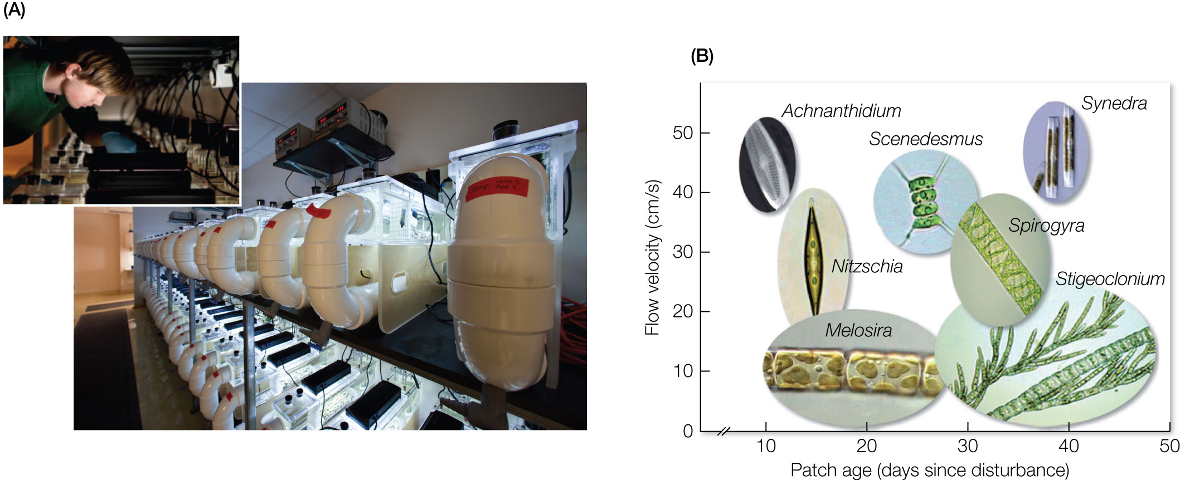
Figure 6.11 Niche partitioning among species of algae improves water quality.
Notes:
Figure 6.11 Niche partitioning among species of algae improves water quality. (A) Researchers manipulated the number of species of green algae and diatoms in artificial streams, called flumes, to determine how biodiversity influences removal of nitrogen pollution from the water. The inset shows a technician taking a sample of algae to analyze them for 15N-labeled nitrate, NO^{3–}, which was added to flumes to simulate pollution. (B) Streams with more species were able to take up more nitrate because of niche partitioning; some species were adapted for environments with high flow in the streams (y axis, top) and others for low flow (y axis, bottom). Some species were adapted for living in frequently disturbed habitats (x axis, left), whereas others were adapted for living in more stable habitats (x axis, right). Because each species dominated a different type of habitat, several species were complementary in their ability to use nitrate from different parts of the streams.

Slide 18
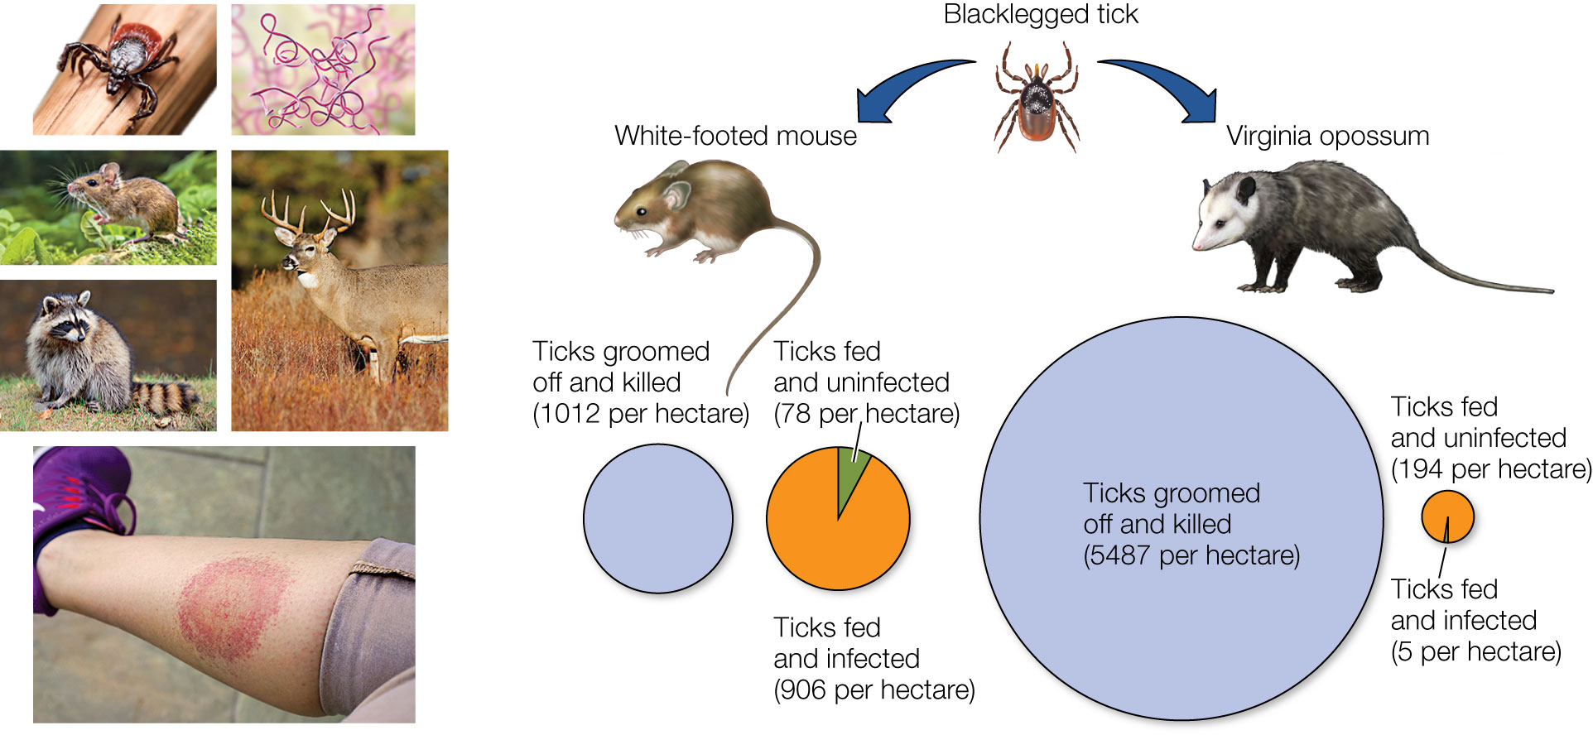
18
Notes:
The dilution effect for Lyme disease. Competent hosts like the white-footed mouse carry the disease-causing bacterium, Borrelia burgdorferi, which they transmit in high frequency to ticks. The infected ticks can then transmit the disease to people. However, transmission rates can be reduced if competent hosts are replaced by noncompetent hosts (e.g., opossums, skunks, raccoons) that reduce the prevalence of Borrelia in ticks. This subsequently reduces risk for humans

Slide 19
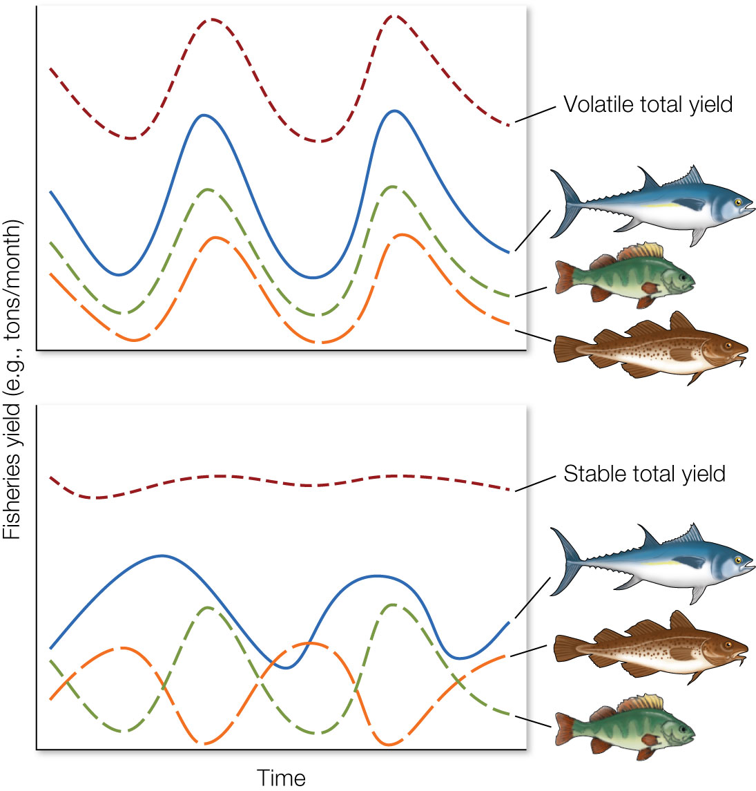
Figure 6.12 Example of how asynchronous dynamics generate the portfolio effect of biodiversity.
Notes:
Figure 6.12 Example of how asynchronous dynamics generate the portfolio effect of biodiversity. In the top graph, the populations of three commercial fish species fluctuate in sync, causing their total production to be volatile over time. In the bottom graph, the three species fluctuate out of sync, which causes their total production to be less volatile over time.

Slide 20
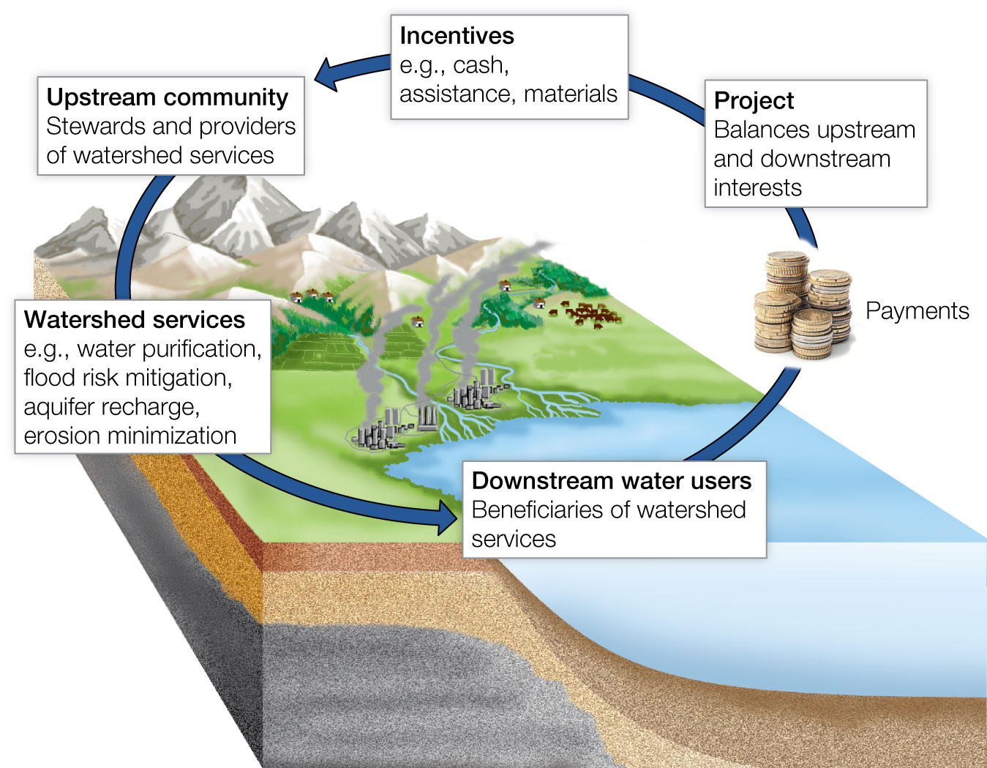
Figure 6.13 Payments for ecosystem services are a set of economic tools used to reward the conservation of those ecosystem services.
Notes:
Figure 6.13 Payments for ecosystem services are a set of economic tools used to reward the conservation of those ecosystem services. Here, the downstream users of a river make payments to upstream users to incentivize them to conserve and be good stewards of the watershed. In return for these payments, downstream users get better water quality and flood control.

